Slide 1

Introduction to Cloud Computing
Concepts, Infrastructure, Security, and Architecture

Slide 2

Cloud Computing Overview
→
Cloud Computing Delivery of computing resources over the internet
→
Resources include compute, storage, networking, databases, and software
→
Key Characteristics
→
• On-demand self-service
→
• Broad network access
→
• Resource pooling
→
• Rapid elasticity
→
• Measured service

Slide 3
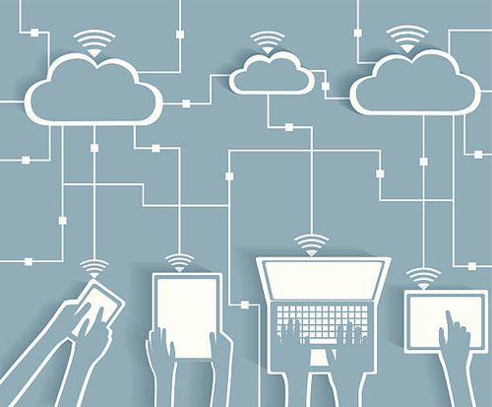
Why Cloud Computing?
Cost Efficiency: Reduces upfront infrastructure costs.
Flexibility: Provides flexible and scalable resources.
Speed: Enables faster deployment of applications.
Accessibility: Supports access from different locations globally.

Slide 4








Core Cloud Concepts
Compute Resources
Storage Resources
Networking Resources
Managed Services
Virtual servers and processing power.
Data storage and databases.
Virtual networks and connectivity.
Services managed by the provider.

Slide 5



Scalability and Elasticity
Scalability
Elasticity
Scalability adds resources as workload grows. It focuses on handling increasing amounts of work by adding more resources to the system.
Elasticity adjusts resources to changing demand. It is the ability to automatically scale resources both up and down as needed.
Pay-as-You-Go Model
Pay for resources based on actual usage. This allows organizations to avoid large upfront investments in physical infrastructure.

Slide 6






Cloud Service Models
IaaS
PaaS
SaaS
Infrastructure as a Service
Platform as a Service
Software as a Service
Provides virtual machines, storage, and networking. Customer manages OS and applications. Example: Amazon EC2
Provides a managed application platform. Provider manages infrastructure. Customer focuses on development.
Provides ready-to-use software over the internet. Provider manages application and infrastructure. Example: Cloud email.

Slide 7
IaaS vs PaaS vs SaaS
Model | Control Level | Customer Responsibilities | Provider Responsibilities
IaaS | Highest | OS, applications, data, runtime | Physical hardware, network, virtualization
PaaS | Medium | Applications, data | Hardware, virtualization, OS, runtime
SaaS | Lowest | Data (typically) | Hardware, virtualization, OS, runtime, applications

Slide 8






Cloud Deployment Models
Public Cloud
Private Cloud
Hybrid Cloud
Infrastructure is operated by a cloud provider. Resources are delivered over a network. Suitable for scalable workloads.
Cloud environment is dedicated to one organization. Provides greater infrastructure control. Can be hosted on-premises or by a provider.
Combines public and private cloud environments. Provides flexibility between environments. Useful when both control and scalability are needed.

Slide 9
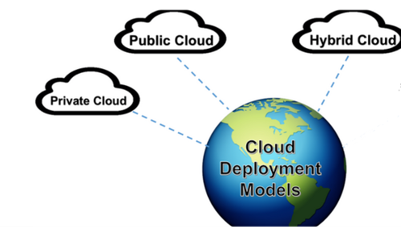
Deployment Model Comparison
→
Public Cloud: High scalability, lower infrastructure management burden.
→
Private Cloud: Greater control, higher infrastructure management responsibility.
→
Hybrid Cloud: Flexible combination of environments, requires integration between environments.

Slide 10



Introduction to Cloud Infrastructure
Cloud Infrastructure Components
Compute, Storage, Networking, Security and management services.
Physical Resources
Virtual Resources
Physical servers and storage provide the underlying physical infrastructure.
Virtual resources allow the physical infrastructure to be shared efficiently among multiple users.

Slide 11
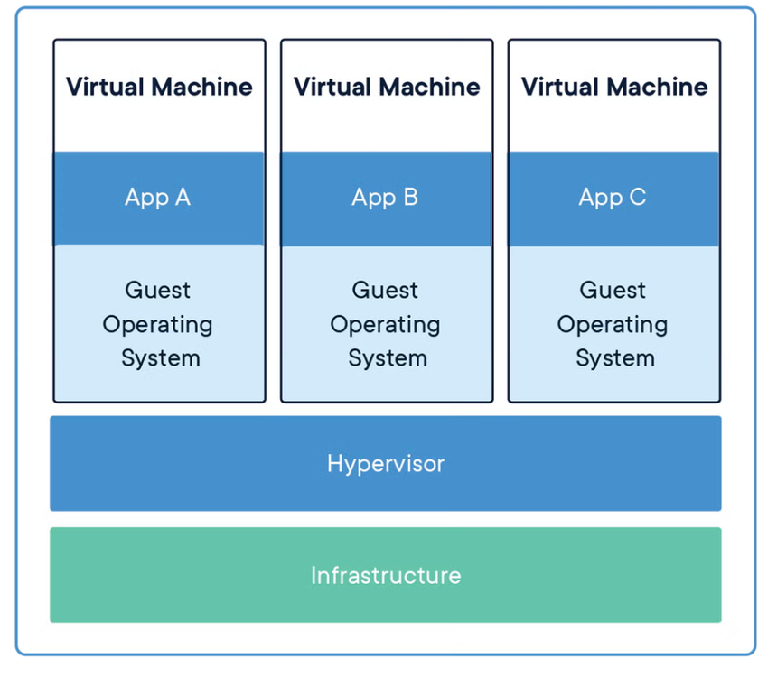
Virtualization Fundamentals
→
What Is Virtualization? Creates virtual versions of computing resources. Allows multiple virtual machines to run on one physical server.
→
Hypervisor Creates and manages virtual machines. Allocates CPU, memory, storage, and network resources.
→
Virtual Machines Each virtual machine can run its own operating system. Virtual machines are isolated from one another.

Slide 12






Types of Virtualization
Server
Storage
Network
Desktop/App
Divides physical server resources among multiple virtual machines.
Combines or abstracts physical storage resources.
Creates logical networks independent of physical network hardware.
Provides virtual desktops or applications to users.

Slide 13
Basic Cloud Architecture
Typical Architecture: Users access applications through networks or the internet. Applications run on cloud compute resources. Data is stored in cloud storage or databases.
Main Layers:
• User and access layer
• Application and compute layer
• Data and storage layer
• Networking and security layer

Slide 14


Benefits of Cloud Computing
Operational Benefits
Business Benefits
→
Scalability and elasticity
→
Flexible operating costs
→
Faster deployment
→
Faster innovation
→
Global availability
→
Support for remote access
→
Reduced hardware maintenance
→
Improved disaster recovery options

Slide 15
Challenges of Cloud Computing
Common Challenges
Management Considerations
→
Security and privacy concerns
→
Monitor resource usage
→
Service outages and availability risks
→
Apply appropriate security controls
→
Vendor lock-in
→
Plan for backup and disaster recovery
→
Cost management

Slide 16
AWS Global Infrastructure
Provides cloud resources across geographic locations.
Designed to support availability, scalability, and low latency.
Major Components:
• Regions
• Availability Zones
• Edge Locations
• AWS Global Network

Slide 17
AWS Regions
What Is an AWS Region?
Choosing a Region
A geographic area containing multiple Availability Zones. Regions are physically isolated and separated from one another to achieve the greatest possible fault tolerance.
→
Consider latency to users
→
Consider service availability
→
Consider compliance and data residency
→
Consider pricing

Slide 18
Availability Zones
What Is an Availability Zone? An isolated location within an AWS Region. Contains one or more physical data centers.
Why Availability Zones Matter:
• Help design highly available applications.
• Allow workloads to be distributed across isolated locations.
• Reduce the impact of failures in a single location.

Slide 19


Edge Locations
What Is an Edge Location?
Benefits
Location used by AWS edge services to deliver content closer to users. Supports services such as Amazon CloudFront (CDN).
→
Reduces network latency.
→
Improves content delivery performance.
→
Brings frequently accessed content closer to users.

Slide 20
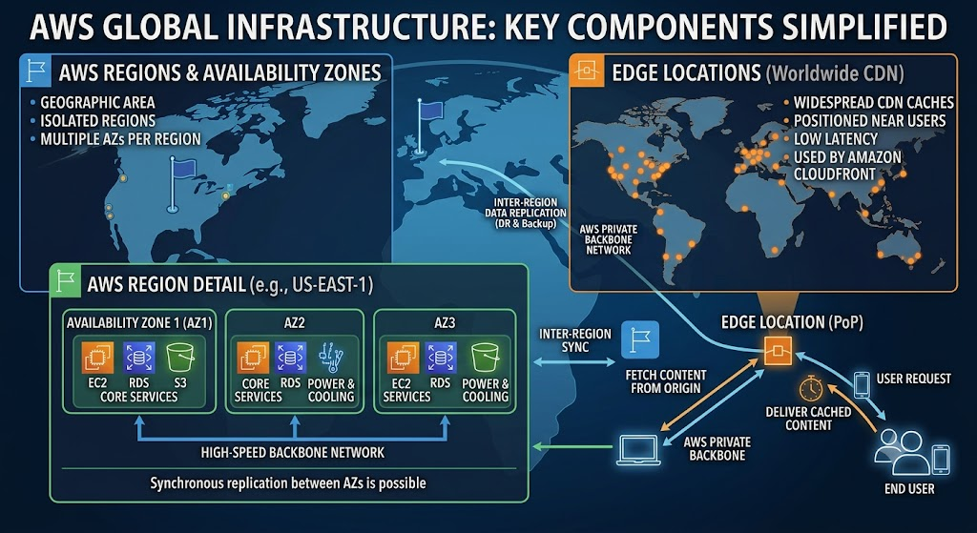

Slide 21

AWS Global Network
→
Global Connectivity: Connects AWS Regions and network locations. Supports reliable and efficient data transfer.
→
Network Design: Applications can use regional resources. Edge services can improve user access performance. Network architecture should consider latency and availability.

Slide 22






Region vs AZ vs Edge Location
AWS Region
Availability Zone
Edge Location
Geographic area containing multiple Availability Zones.
Isolated location within a Region.
Location used by edge services to serve users closer to their location.

Slide 23
Example of AWS Global Architecture
Users access an application.
Edge services can deliver content closer to users.
Application resources run in an AWS Region.
Resources can be distributed across Availability Zones.

Slide 24
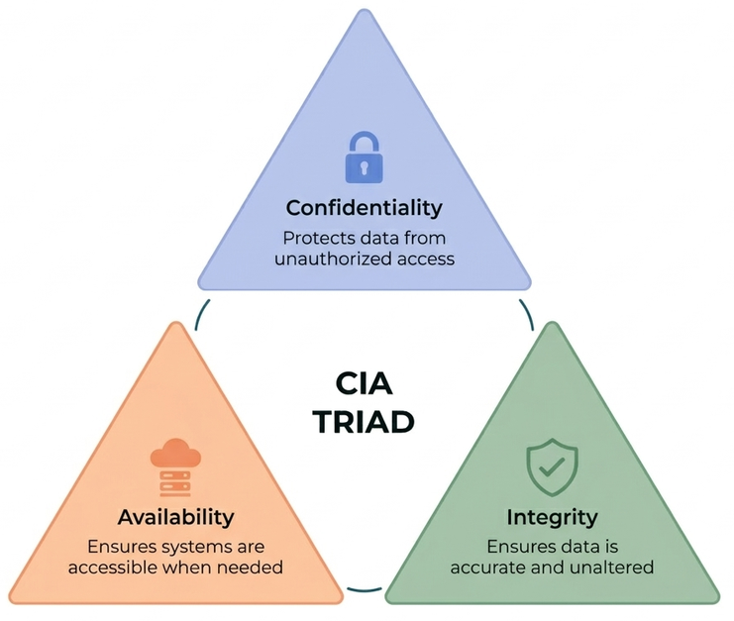
Introduction to Cloud Security
→
Cloud Security: Protects cloud systems, applications, data, and identities. Requires security controls from both provider and customer.
→
Security Goals:
→
• Confidentiality
→
• Integrity
→
• Availability

Slide 25



AWS Shared Responsibility Model
Shared Responsibility
AWS is responsible for security OF the cloud.
Customers are responsible for security IN the cloud.
AWS Responsibilities
Customer Responsibilities
→
Physical data centers
→
Data and applications
→
Underlying hardware
→
Identity and access management
→
Core cloud infrastructure
→
OS and configuration (where applicable)
→
Security settings for managed resources

Slide 26






Fundamental Cloud Security Principles
Identity & Access
Data Protection
Monitoring & Logging
Use strong authentication. Apply least-privilege access. Grant only required permissions.
Protect sensitive data during storage and transmission. Use encryption where appropriate. Manage access carefully.
Monitor cloud activity. Maintain useful logs. Investigate unusual activity.

Slide 27


Network and Infrastructure Security
Network Controls
Secure Configuration
→
Use appropriate network segmentation.
→
Use secure default configurations.
→
Control inbound and outbound traffic.
→
Keep systems and software updated.
→
Restrict unnecessary access.
→
Regularly review security settings.

Slide 28
Cloud Deployment in the Real World
Why Organizations Use Cloud
Deployment Approach
→
Application hosting
→
Select a suitable service model.
→
Data storage and analytics
→
Select an appropriate deployment model.
→
Backup and disaster recovery
→
Design for security, availability, and scalability.
→
Websites and digital services

Slide 29


Public Cloud Case Study
Example Scenario
Architecture Considerations
An online application needs resources that can scale with user demand. The organization chooses public cloud infrastructure.
→
Cloud compute resources host the application.
→
Cloud storage or databases store application data.
→
Security controls protect access and data.
→
Resources can scale as demand changes.

Slide 30
Private Cloud Case Study
Example Scenario
Architecture Considerations
An organization requires greater control over its cloud environment. A private cloud is used for dedicated workloads.
→
Dedicated infrastructure.
→
Controlled access.
→
Organization manages more of the environment.

Slide 31
Hybrid Cloud Case Study
Example Scenario
Architecture Considerations
An organization keeps selected workloads in a private environment. Additional workloads use public cloud resources.
→
Secure connectivity between environments.
→
Consistent identity and access controls.
→
Careful data and workload placement.

Slide 32


Cloud Architecture Review
Architecture Checklist
Design Principles
→
Is the architecture scalable?
→
Use appropriate cloud services.
→
Is it highly available?
→
Avoid unnecessary complexity.
→
Are security controls included?
→
Design for failure.
→
Are data and access properly protected?
→
Monitor and continuously improve.
→
Are costs monitored?

Slide 33
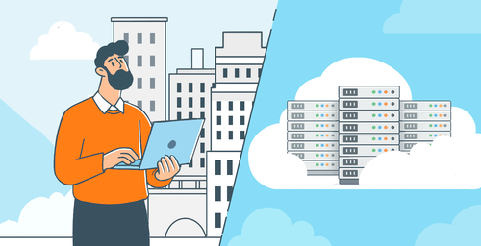
Choosing the Right Cloud Model
Decision Factors
•
Business requirements
•
Security and compliance needs
•
Performance and latency
•
Budget and cost model
•
Scalability requirements
General Guidance
•
Public cloud for flexibility and scalability.
•
Private cloud for greater control.
•
Hybrid cloud when both environments are needed.

